Slide 1

Project ON “CUSTOMER RETENTION”
Presented By: Mr. T.N.K PRAVEEN

Slide 2
TOPICS:
Overview.
Problem Statement.
Problem Understanding.
Exploratory data analysis.
Visualizations.
Analysis.
Model Building.
Hyper Parameter Tunning.
Saving the best model.
Conclusion.

Slide 3
Overview:
In this particular presentation we will be looking on:
What are the EDA steps in cleaning the dataset.
Overall analysis on the problem.
Model building from Customer Retension dataset.
Predicting Customer Retention.

Slide 4
Problem Statement:
E-retail factors for customer activation and retention: A case study from Indian e-commerce customers

Slide 5
Problem Understanding:
Customer satisfaction has emerged as one of the most important factors that guarantee the success of online store; it has been posited as a key stimulant of purchase, repurchase intentions and customer loyalty. A comprehensive review of the literature, theories and models have been carried out to propose the models for customer activation and customer retention. Five major factors that contributed to the success of an e-commerce store have been identified as: service quality, system quality, information quality, trust and net benefit. The research furthermore investigated the factors that influence the online customers repeat purchase intention. The combination of both utilitarian value and hedonistic values are needed to affect the repeat purchase intention (loyalty) positively. The data is collected from the Indian online shoppers. Results indicate the e-retail success factors, which are very much critical for customer satisfaction.

Slide 6
What is Customer Retention?
Customer retention refers to the ability of a company or product to retain its customers over some specified period. High customer retention means customers of the product or business tend to return to, continue to buy or in some other way not defect to another product or business, or to non-use entirely. Selling organizations generally attempt to reduce customer defections. Customer retention starts with the first contact an organization has with a customer and continues throughout the entire lifetime of a relationship and successful retention efforts take this entire lifecycle into account. A company's ability to attract and retain new customers is related not only to its product or services, but also to the way it services its existing customers, the value the customers actually perceive as a result of utilizing the solutions, and the reputation it creates within and across the marketplace.
Successful customer retention involves more than giving the customer what they expect. Generating loyal advocates of the brand might mean exceeding customer expectations. Creating customer loyalty puts 'customer value rather than maximizing profits and shareholder value at the centre of business strategy'. The key differentiation in a competitive environment is often the delivery of a consistently high standard of customer service. Furthermore, in the emerging world of Customer Success, retention is a major objective.

Slide 7
Exploratory Data Analysis (E.D.A):
While checking for null values in data set I found no null values are present in the data set.
By info() function also found that there are no missing data was present in the given data set.
And all these steps were performed to both train and test datasets separately.
This data set is of Classification model So used the classification algorithms for best accuracy to get.

Slide 8
Analysis:
I have used Count plot for each pair of categorical & Numerical features that shows the relation.
And also used the Pie plot for some categorical columns to get better insights to get from data.
I found that Amazon store performs good and giving safety and playful experience to the customer comparing to others.
I checked this comparison through the Bar Graph.

Slide 9
Data Cleaning Steps:
In my datasets I can’t found any missing/null values in the data set.
I have changed the lengthy column names to short names to see in better way.
To encode the categorical columns I have use Ordinal Encoding.
After Done visualization through each data columns to get better insights in it for getting idea about how the data is behaving.
Depending on the above terms found the best model which suits better for this data set.

Slide 10
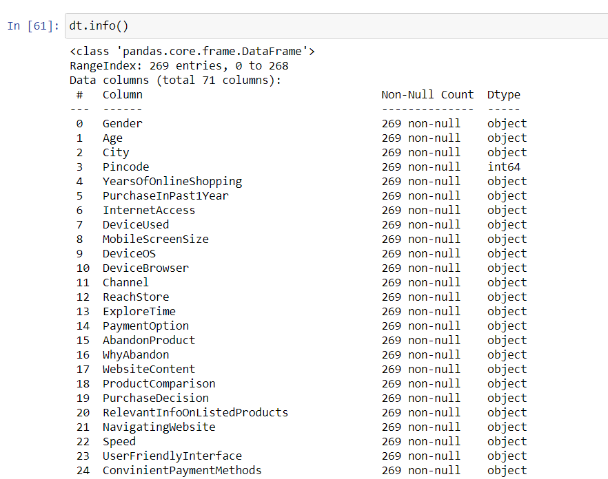
CHECKING FULL INFORMATION ABOUT THE DATA :-
By the info() function found the full details about the data.

Slide 11
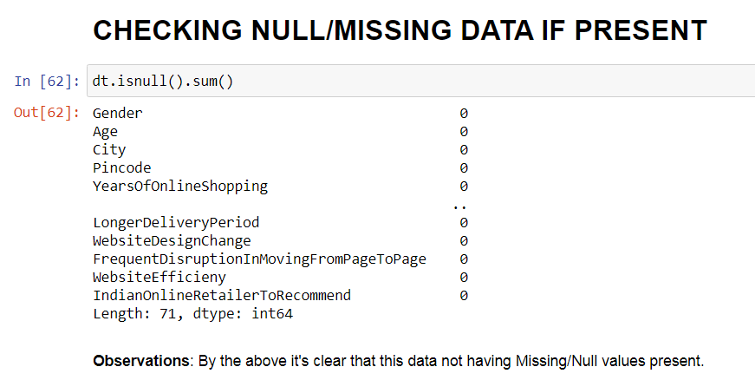
EXTRAPOLATORY DATA ANALYSIS (EDA):-
Checking Missing/Null values of Data Set.

Slide 12
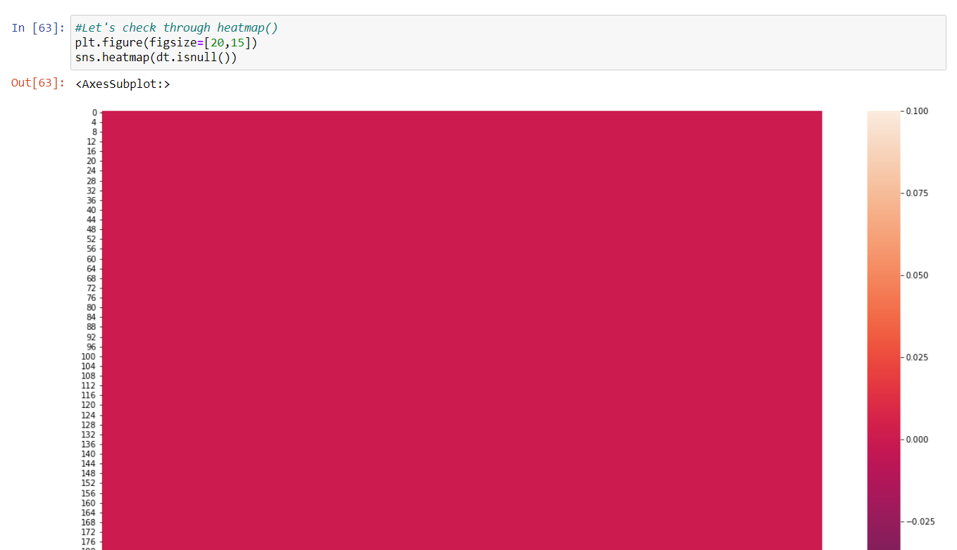
EXTRAPOLATORY DATA ANALAYSIS (EDA):-
As in above checked and clear that there is no missing data Available in Data set.
Now checking through Graphically i.e by Heat Map visualization.
Heat Map is used to check Null/Missing Data.

Slide 13
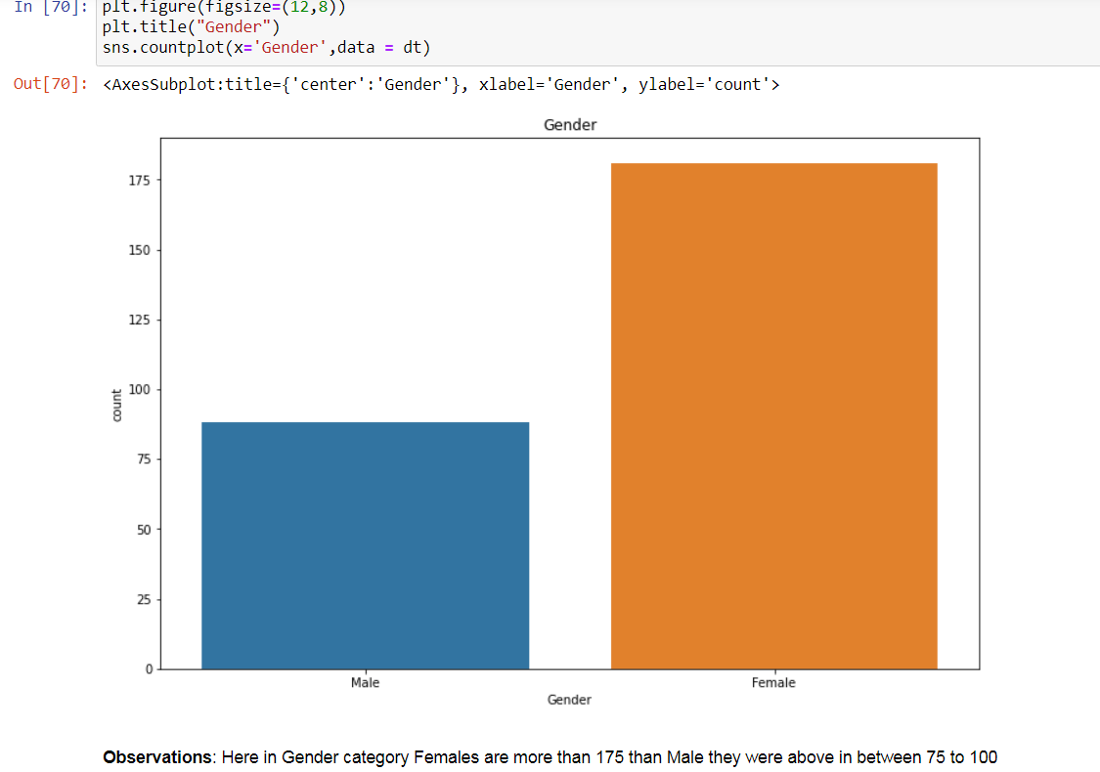
VISUALIZATION (COUNT PLOT):-
Now checking count plot for Gender column.

Slide 14
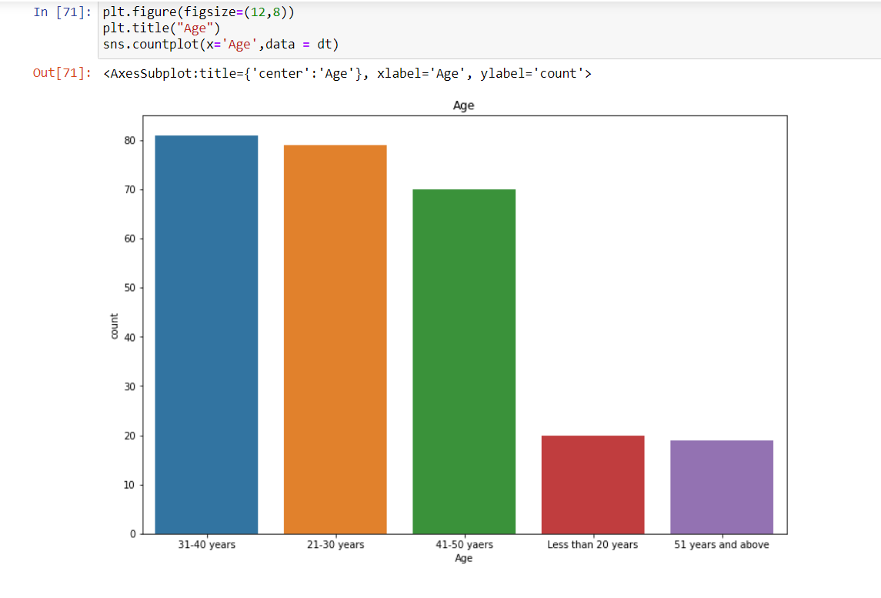
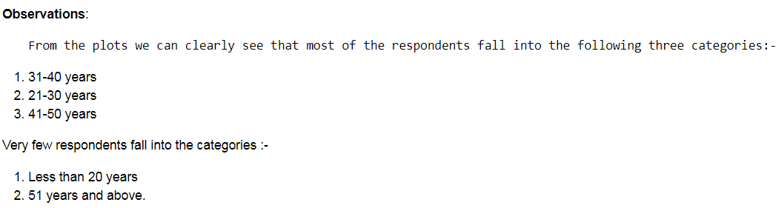
VISUALIZATION (COUNT PLOT):-
Using Count plot for Age column.

Slide 15
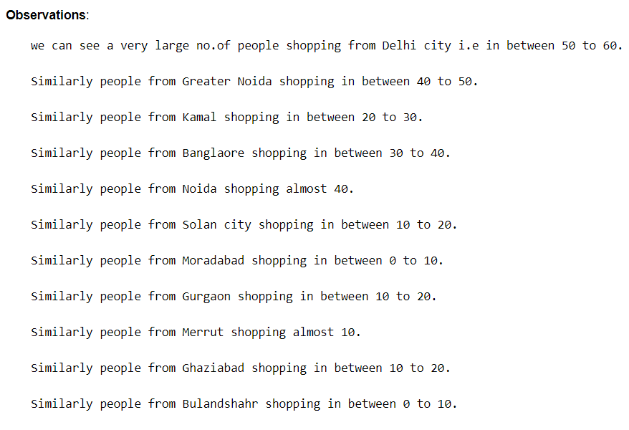
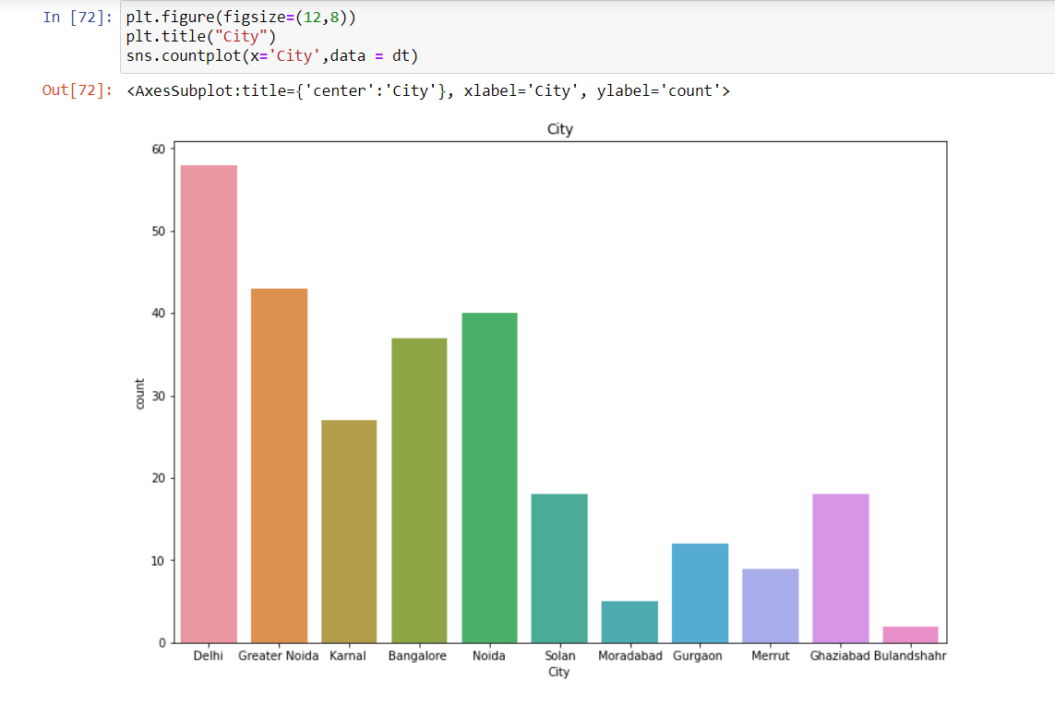
VISUALIZATION (COUNT PLOT):-
Checking Count Plot for City column.

Slide 16
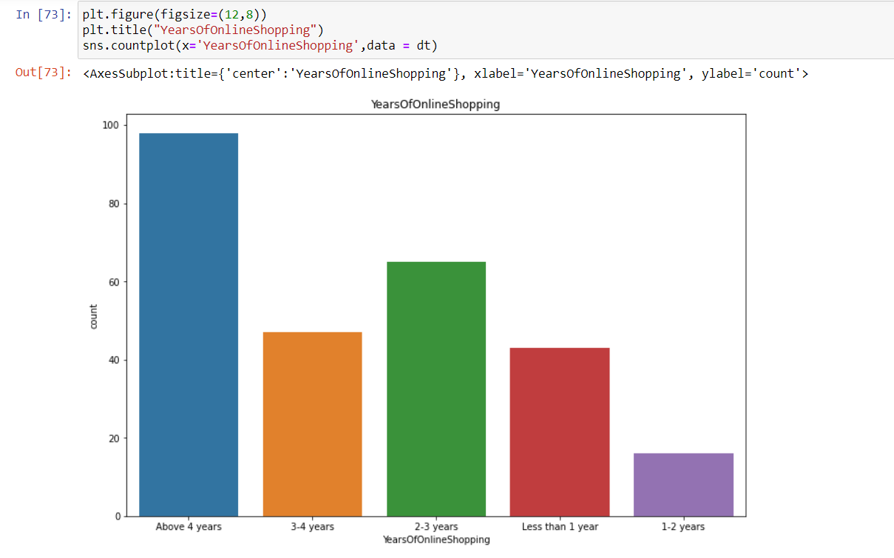
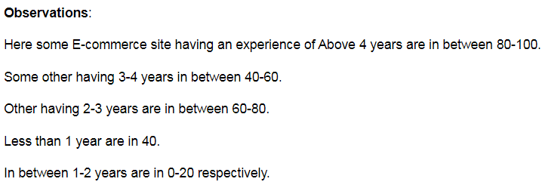
VISUALIZATION (COUNT PLOT):-
Using Count plot for YearsofOnlineshopping column.

Slide 17
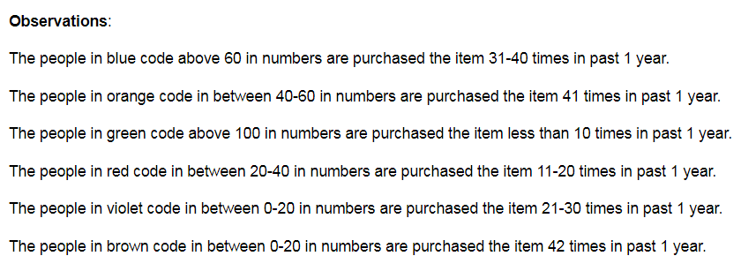
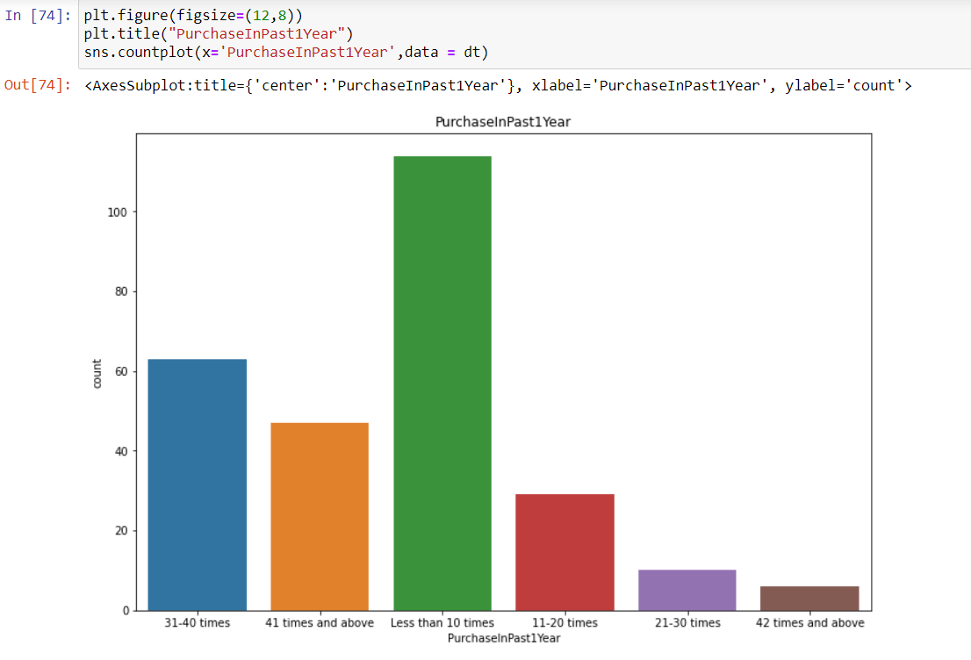
VISUALIZATION (COUNT PLOT):-
Using Count plot for PurchaseInPastYear column

Slide 18
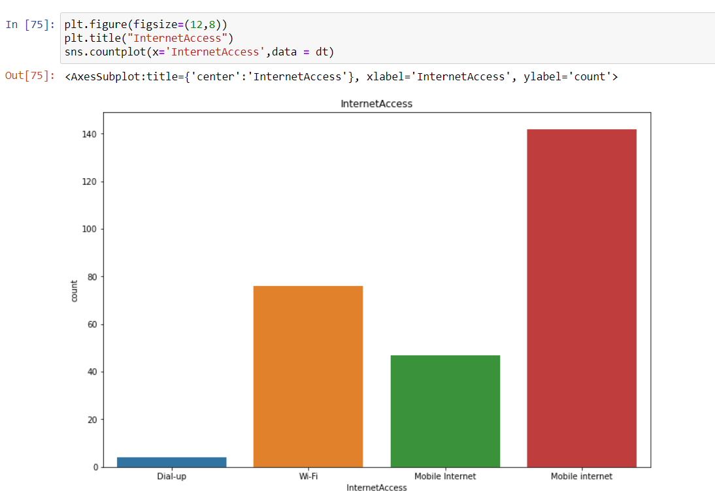
VISUALIZATION (COUNT PLOT):-
Using count plot for InternetAccess column.

Slide 19
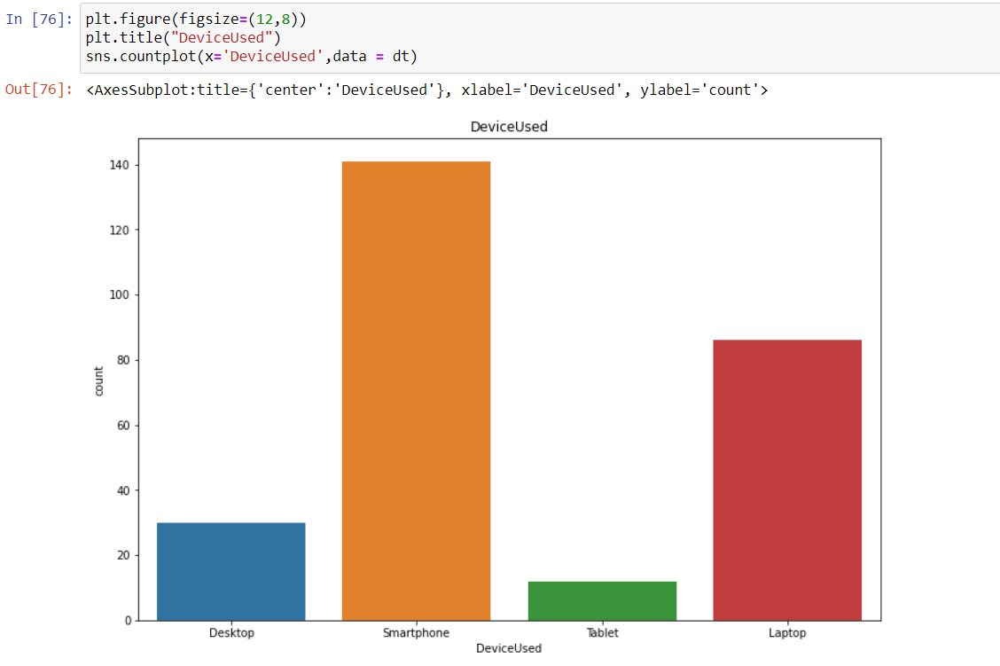
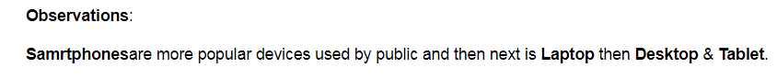
VISUALIZATION (COUNT PLOT):-
Using Count plot for Deviceused column.

Slide 20
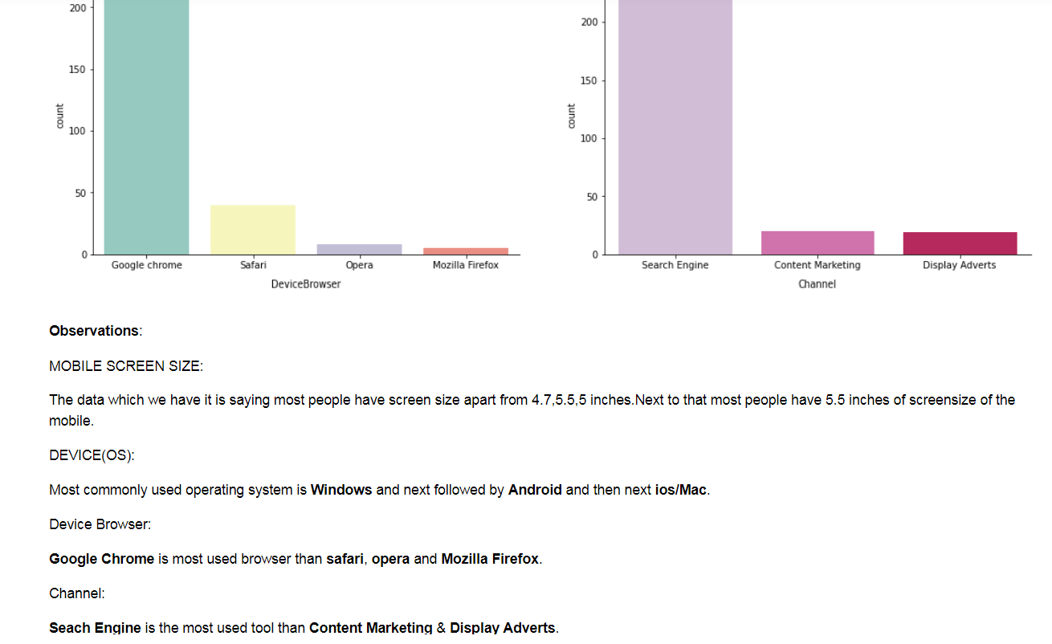
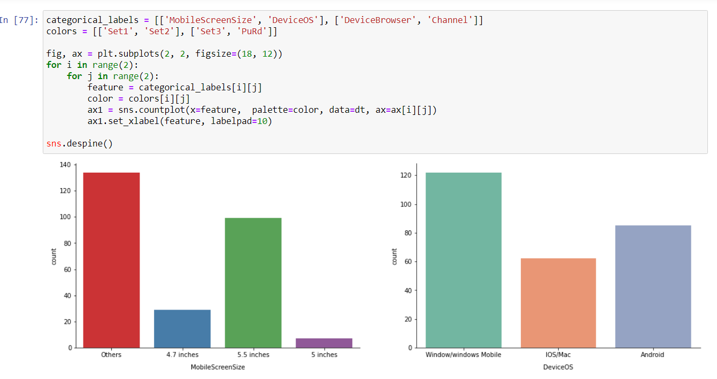
VISUALIZATION (COUNT PLT):-
Using Count plot for MobileScreen , DeviceOs, DeviceBrowser, Channel1 columns.

Slide 21
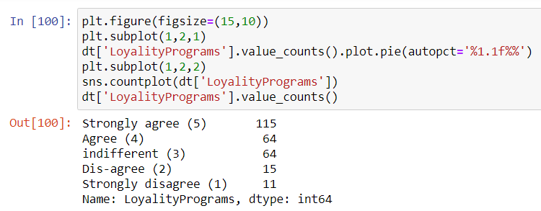
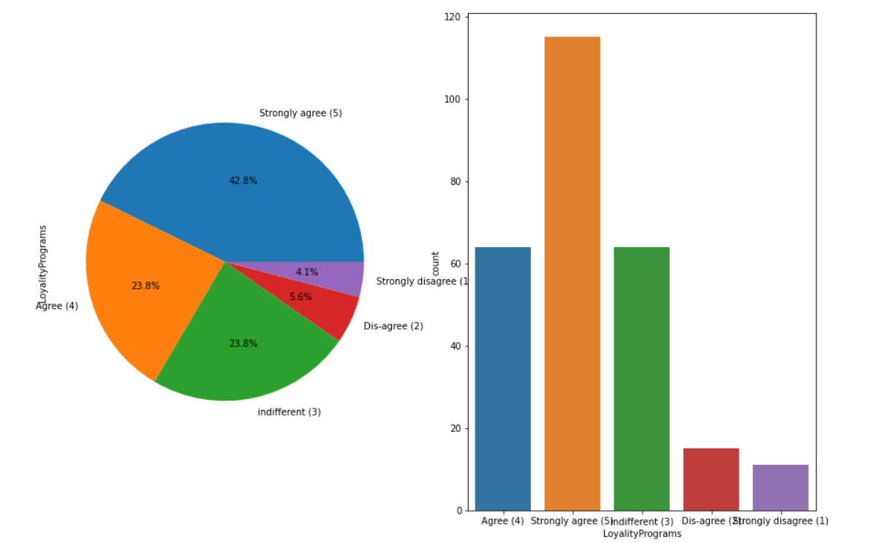
VISUALIZATION (COUNT & Pie PLOT):-
Using count & pie plot checking for Loyalty column.

Slide 22
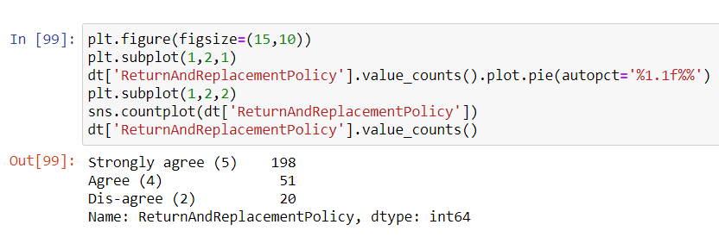
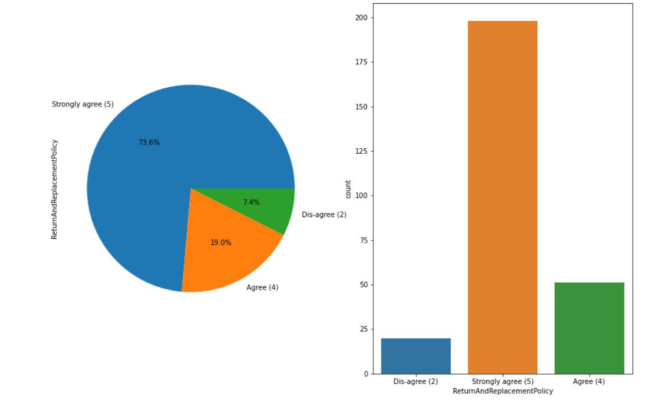
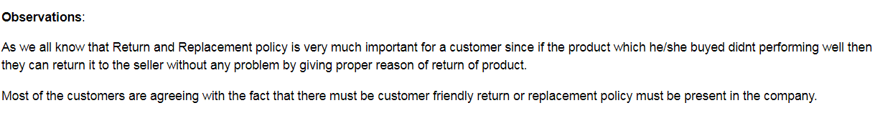
VISUALIZATION (COUNT & PIE PLOT):-
Using count & pie plot checking for ReturnAndReplacementPolicy column.

Slide 23
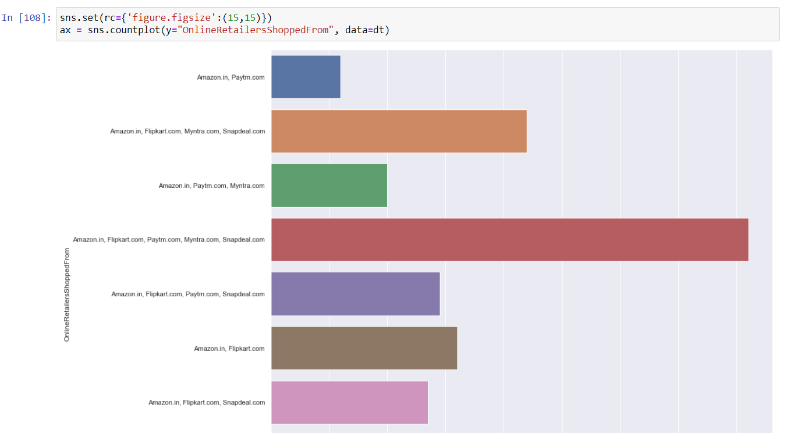
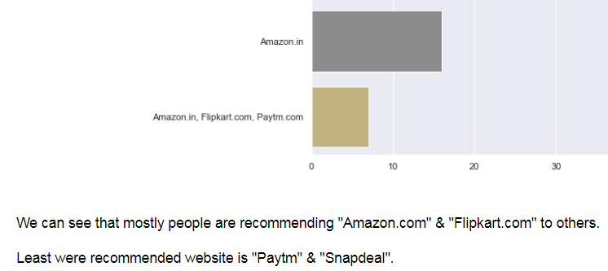
VISULIZATION (BAR PLOT):-
Using Bar plot for OnlineRetailersShopped column.

Slide 24
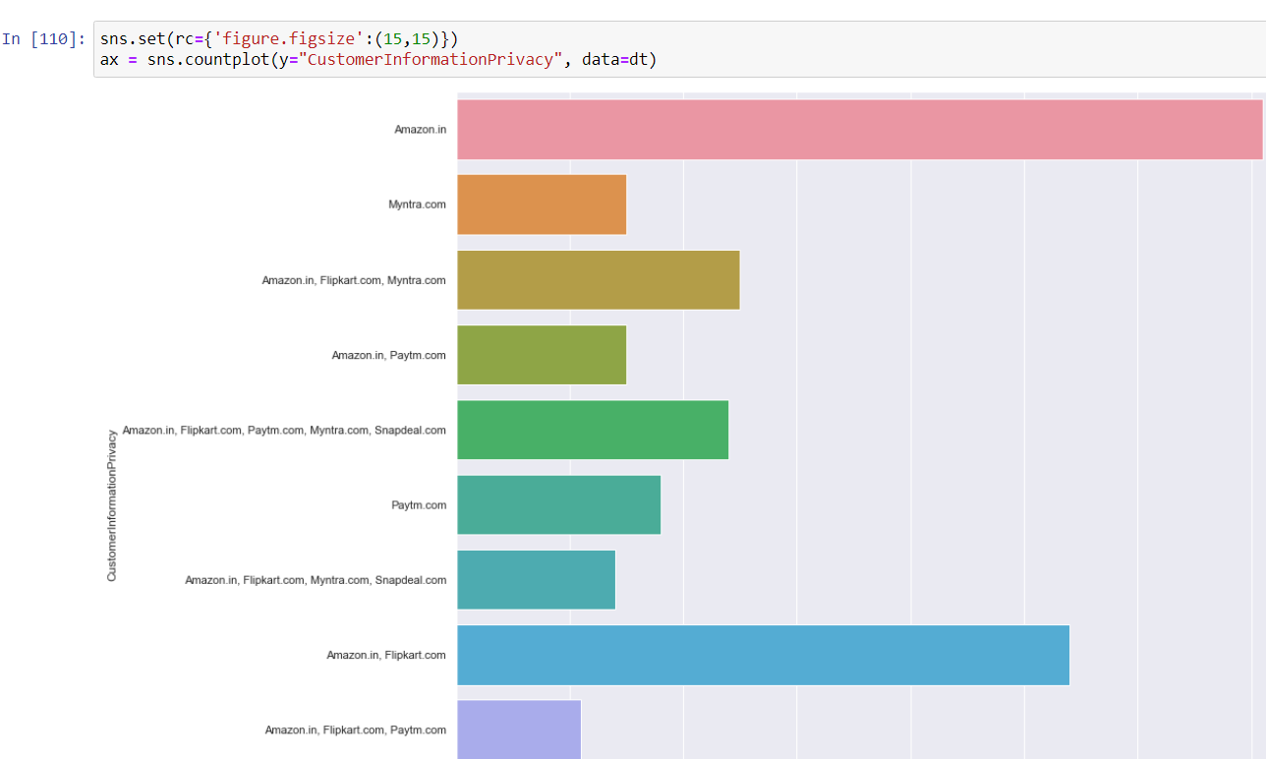
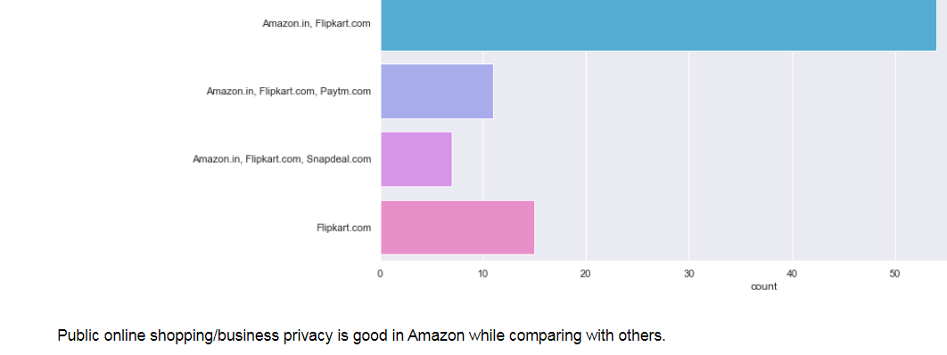
VISUALIZATION (BAR PLOT):-
Using Bar Plot checking the Customer Information Privacy column.

Slide 25
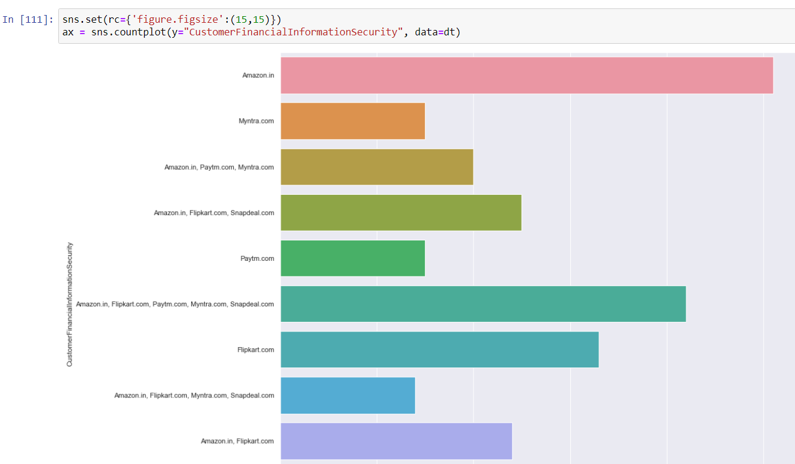
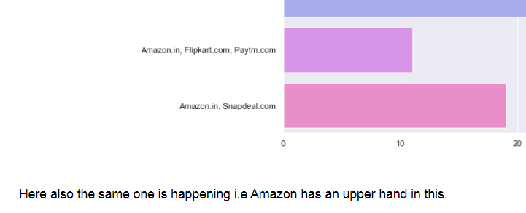
VISUALIZATION (BAR PLOT):-
Using Bar Plot checking CustomerFinanceInformationSecurity column.

Slide 26
Model Building:
Since this particular problem was Classification problem. And I have used classification algorithms to build my model. Now by looking model accuracy score and mean of cross validation score I found both Random Forest Classifier and XG Boost Classifier are best model with 81% Accuracy for confusion matrix and 96.6% for mean of cross validation score. Also used the confusion matrix and I have gone through cross validation test report. Below are the list of Classification models have used in my project.
RandomForestClassifier.
XG BoostClassifier.

Slide 27
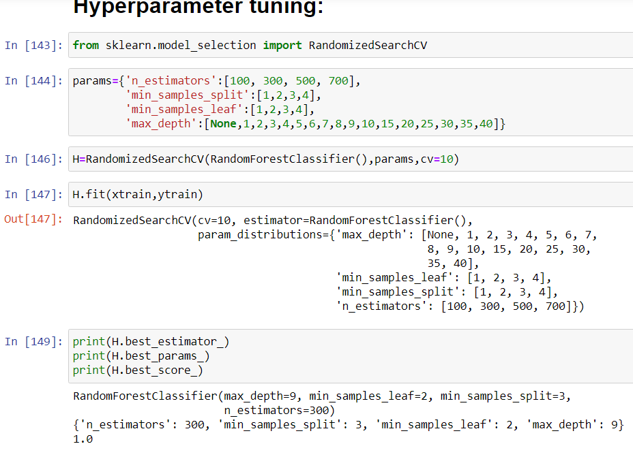
Hyper Tuning The Model and also finding accuracy score of model:
I have Hyper tuned the Model

Slide 28
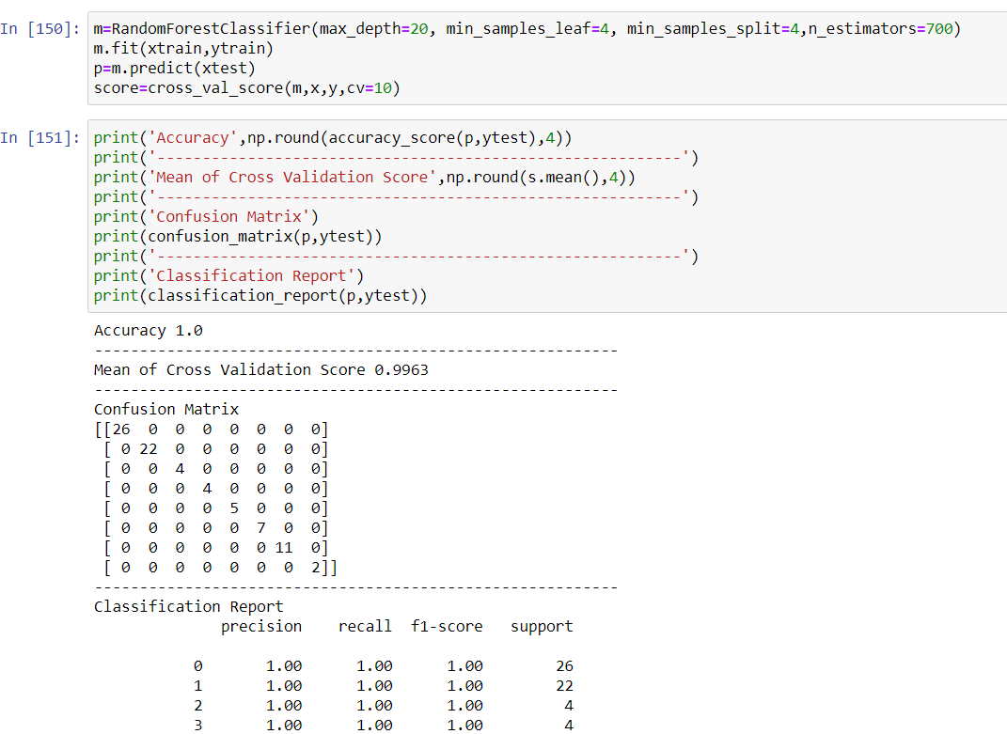
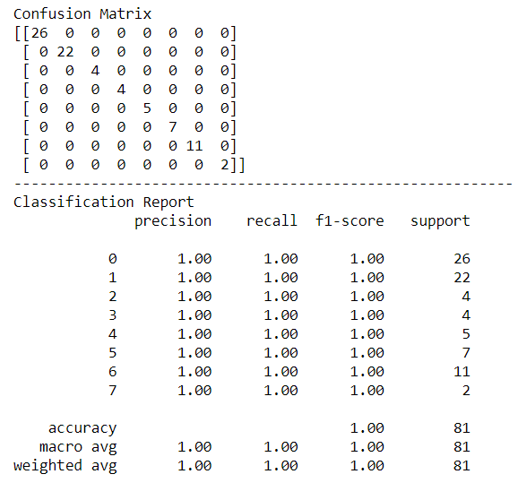
RANDOM FOREST CLASSIFIER
Mean of CROSS VALIDATION SCORE FOR RANDOMFORESTCLASSIFIER IS 99.6% & Accuracy score CLASSIFICATION REPORT using confusion matrix is 81%

Slide 29
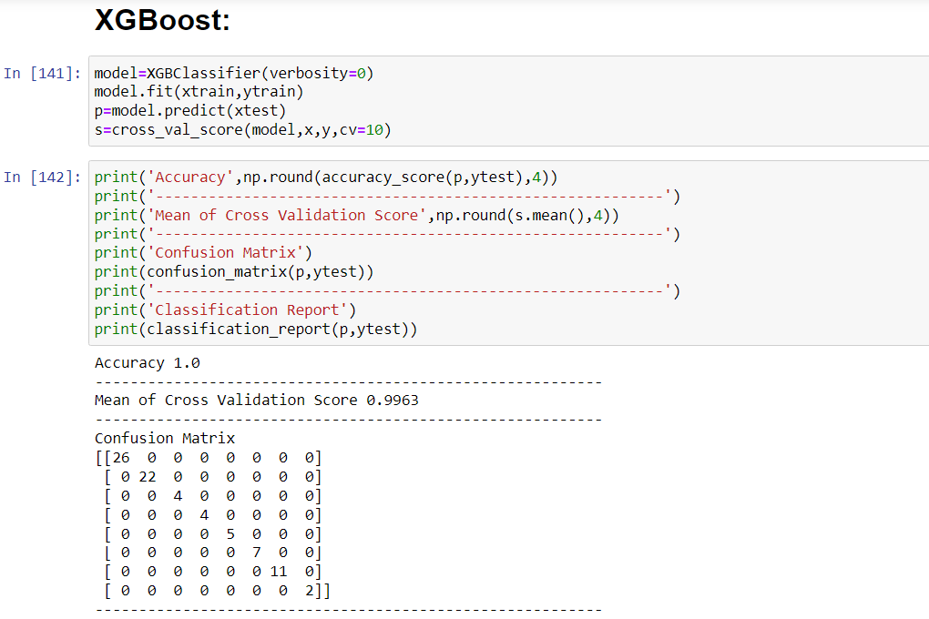
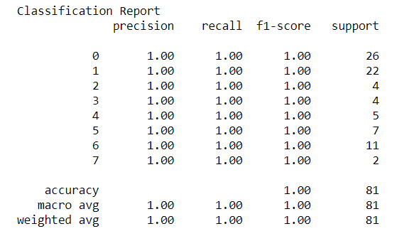
XG BOOST CLASSIFIER
Mean of CROSS VALIDATION SCORE FOR XGBOOST CLASSIFIER IS 99.6% & Accuracy score CLASSIFICATION REPORT using confusion matrix is 81%

Slide 30
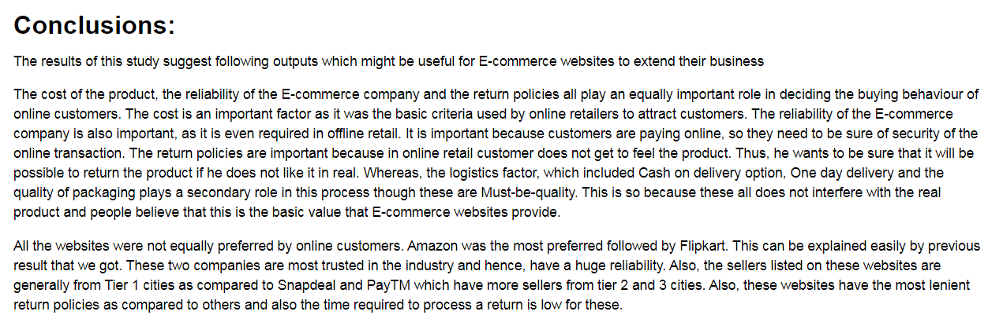
Conclusion:

Slide 31


